Slide 1
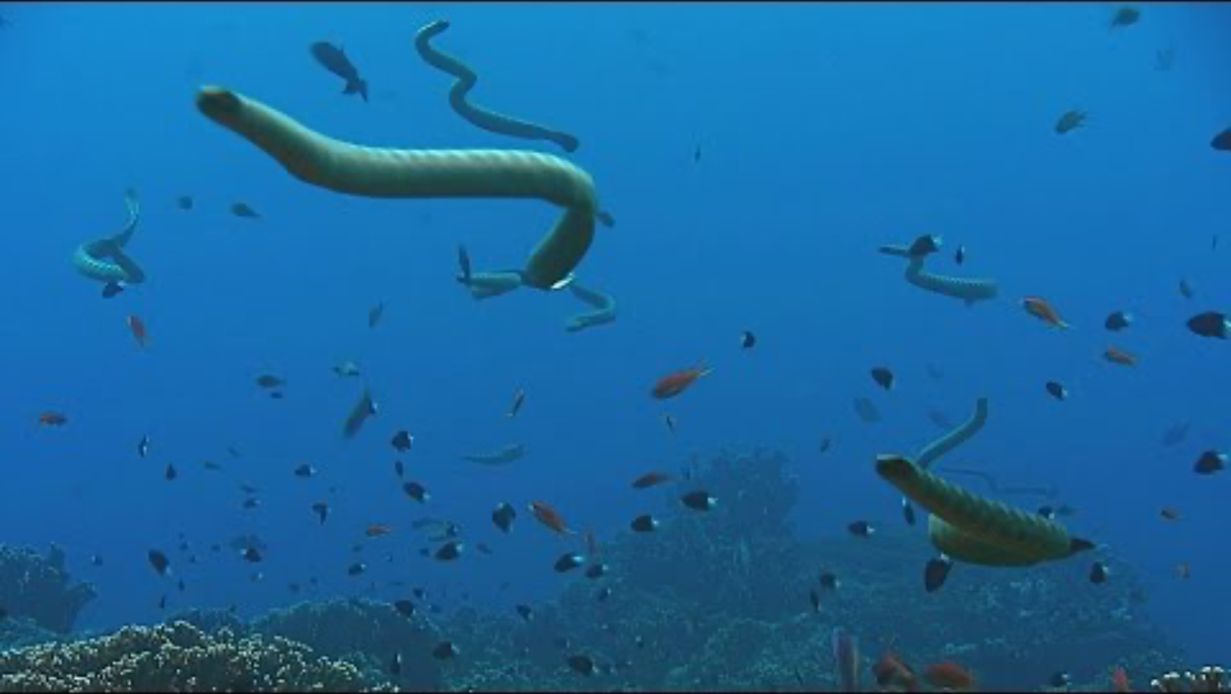
Emma Sherratt, Jenna Crowe-Riddell, Alessandro Palci, Ammresh, Mark N. Hutchinson, Michael S.Y. Lee, Kate L. Sanders. 2025. “Rapid evolution and cranial morphospace expansion during the terrestrial to marine transition in elapid snakes” Evolution, 2025, 0(0), 1–13 https://doi.org/10.1093/evolut/qpaf180
https://www.youtube.com/watch?v=8E_I4AgsIok
Class focus area: Multivariate morphometrics
EEB603: Brian O’Meara
All quotes and images from the above paper unless otherwise noted

Slide 2
In what ways can a continuous trait change in an instant of time?
Randomly: increase or decrease slightly by chance
and/or
Directionally: be pulled towards some value

Slide 3
In what ways can a continuous trait change in an instant of time?
Randomly: increase or decrease slightly by chance
and/or
Directionally: be pulled towards some value

Slide 4
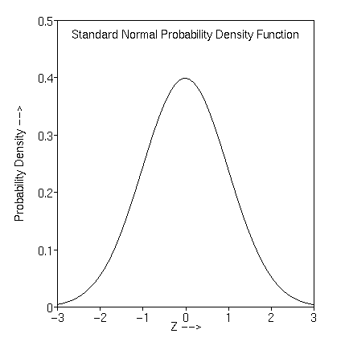
In what ways can a continuous trait change in an instant of time?
Randomly: increase or decrease slightly by chance
and/or
Directionally: be pulled towards some value

Slide 5
In what ways can a continuous trait change in an instant of time?
Randomly: increase or decrease slightly by chance
and/or
Directionally: be pulled towards some value
Rate of wiggle

Slide 6
In what ways can a continuous trait change in an instant of time?
Randomly: increase or decrease slightly by chance
and/or
Directionally: be pulled towards some value

Slide 7
In what ways can a continuous trait change in an instant of time?
Randomly: increase or decrease slightly by chance
and/or
Directionally: be pulled towards some value
Adds the entire difference

Slide 8
In what ways can a continuous trait change in an instant of time?
Randomly: increase or decrease slightly by chance
and/or
Directionally: be pulled towards some value
Allows directional change less than 100% (even zero)

Slide 9
In what ways can a continuous trait change in an instant of time?
Randomly: increase or decrease slightly by chance
and/or
Directionally: be pulled towards some value
Ornstein-Uhlenbeck process

Slide 10


Ornstein-Uhlenbeck process

Slide 11
1
1
1
1
1

Slide 12
2
2
2
2
2

Slide 13
3
3
3
3
3

Slide 14
And so forth...
3
3
3
3
3

Slide 15
 | General | Single rate Brownian motion | Multiple mean Ornstein-Uhlenbeck | Multiple rate Brownian motion | Everything
 | vary | all equal | all equal | some vary | some vary
 | vary | 0 | all equal | 0 | some vary
 | vary | NA | some vary | NA | some vary
Ex. | - | Indep. contrasts (Felsenstein, 1985), ANCML (Schluter et. al, 1998) | Hansen, 1997; OUCH (Butler & King, 2004) | Brownie (O’Meara et al., 2006, Thomas et al., 2006) | OUwie (Beaulieu et al. 2012)
Brownian rate
OU attraction
OU mean

Slide 16
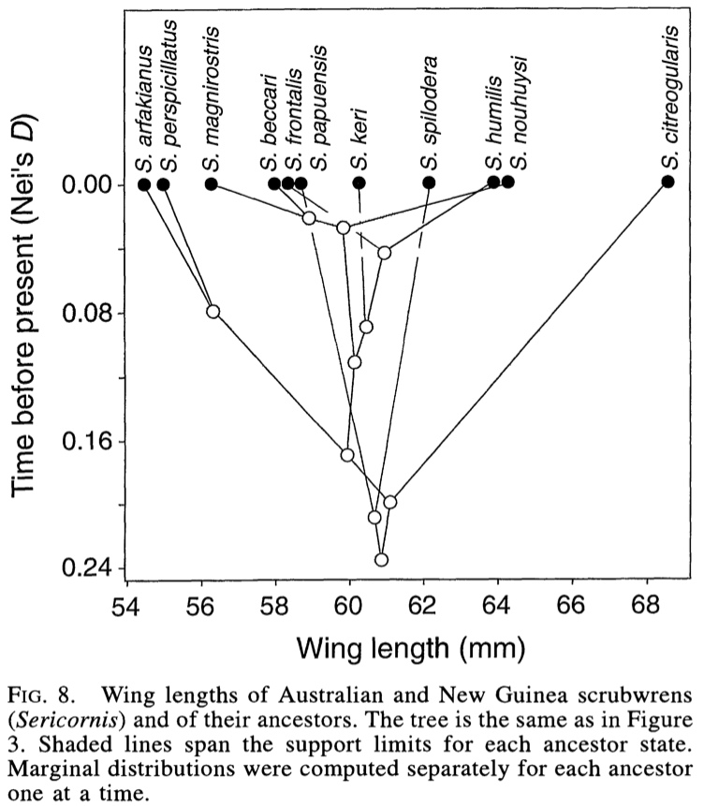
Schluter et al. 1997
Notes:
Use to explain ridge regression

Slide 17
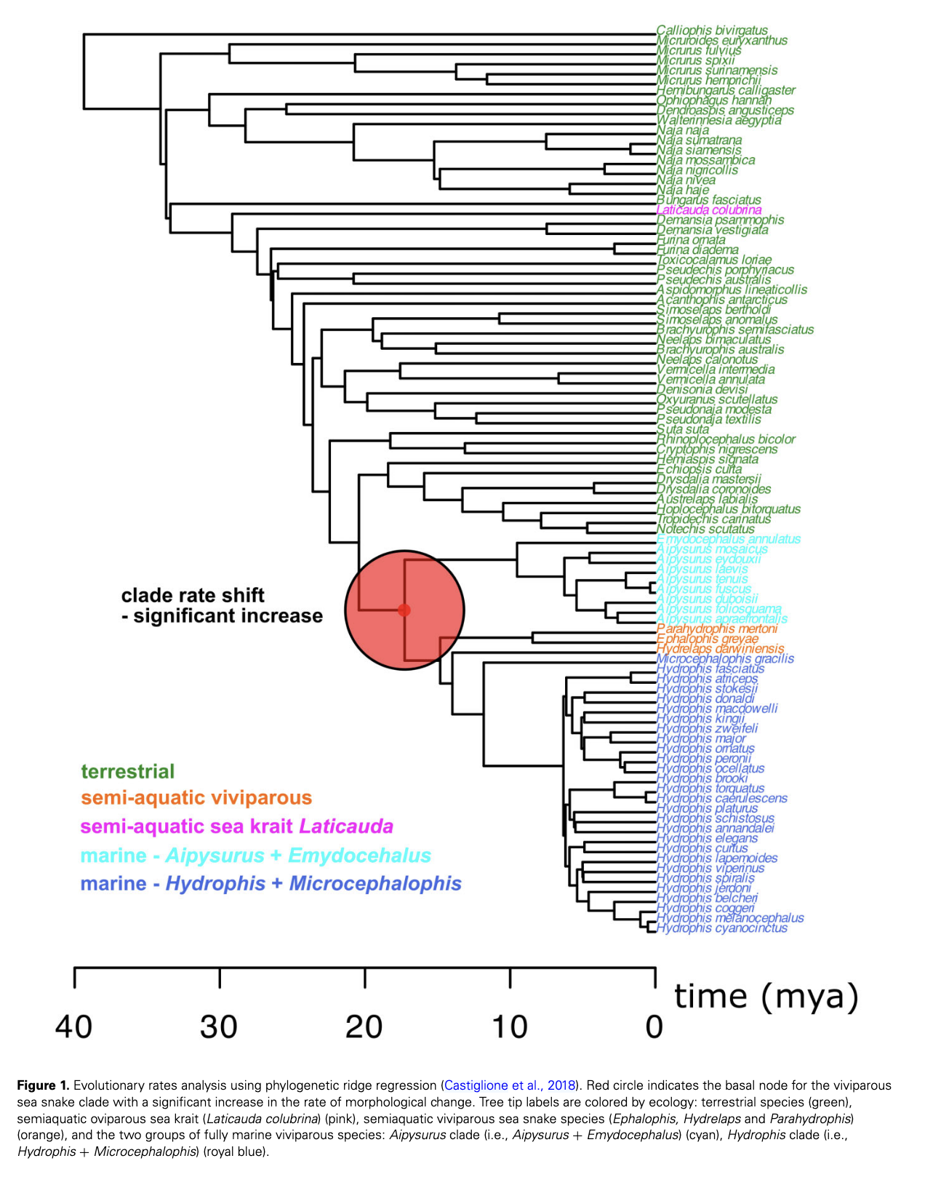

Slide 18
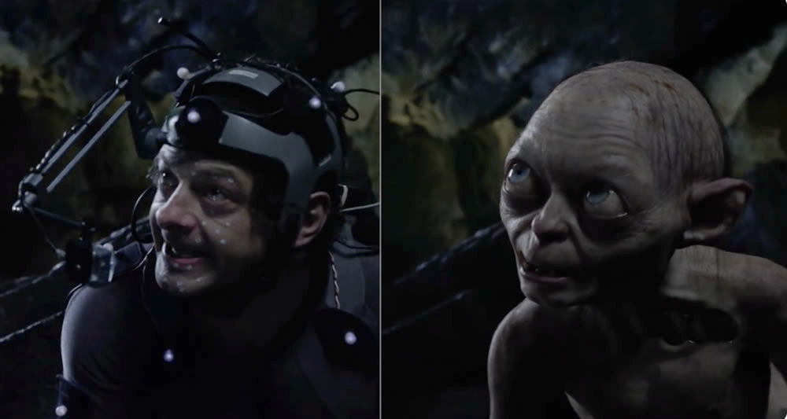
https://www.makinaegitimi.com/motion-capture-hareket-yakalama-teknolojisi/

Slide 19
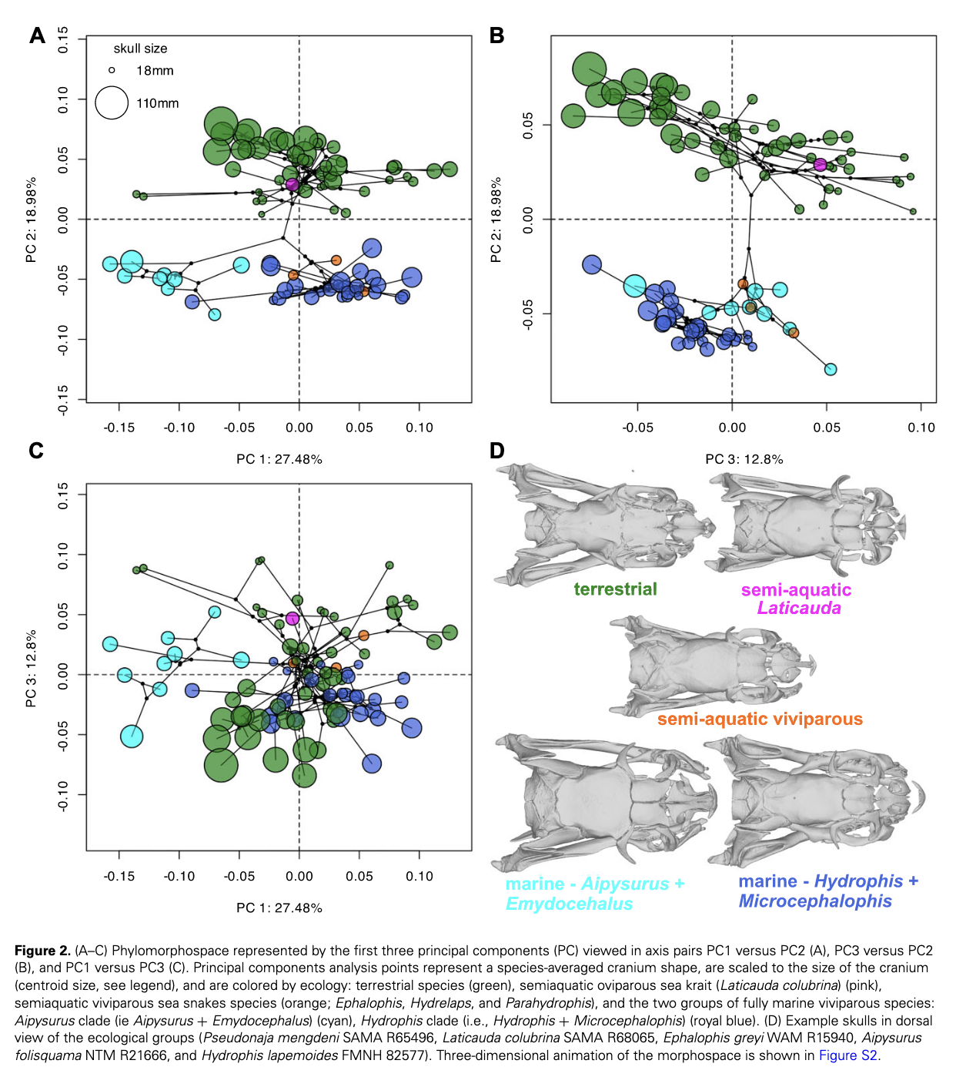

Slide 20
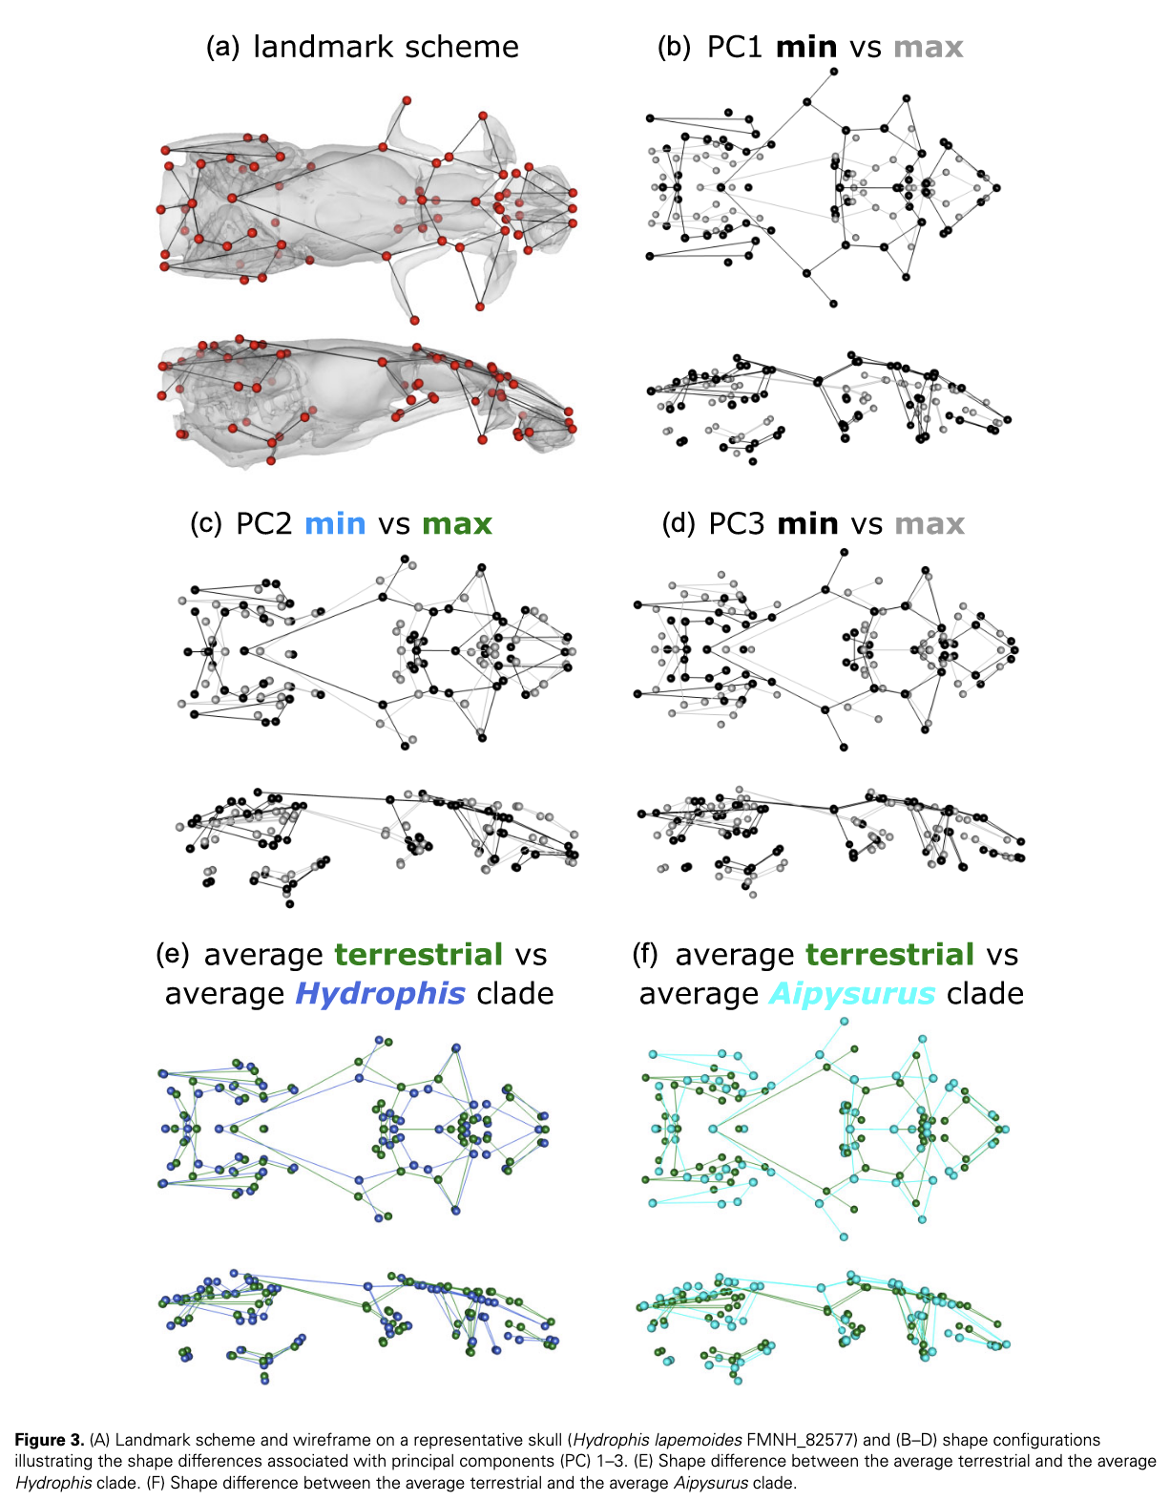

Slide 21
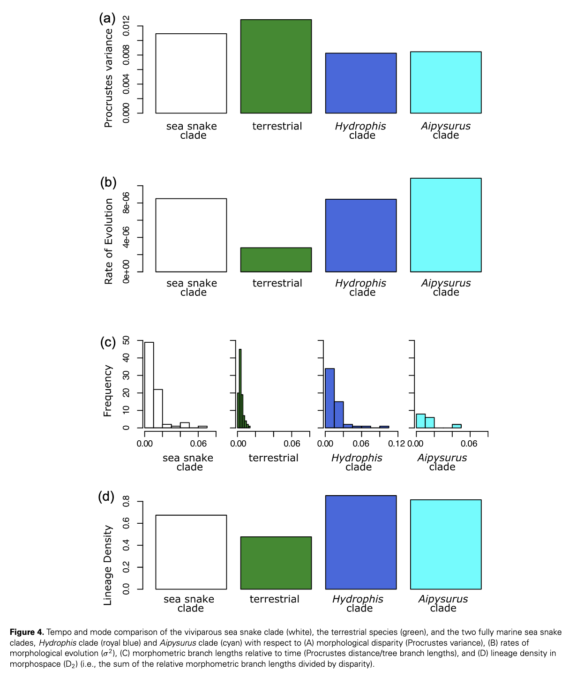

Slide 22
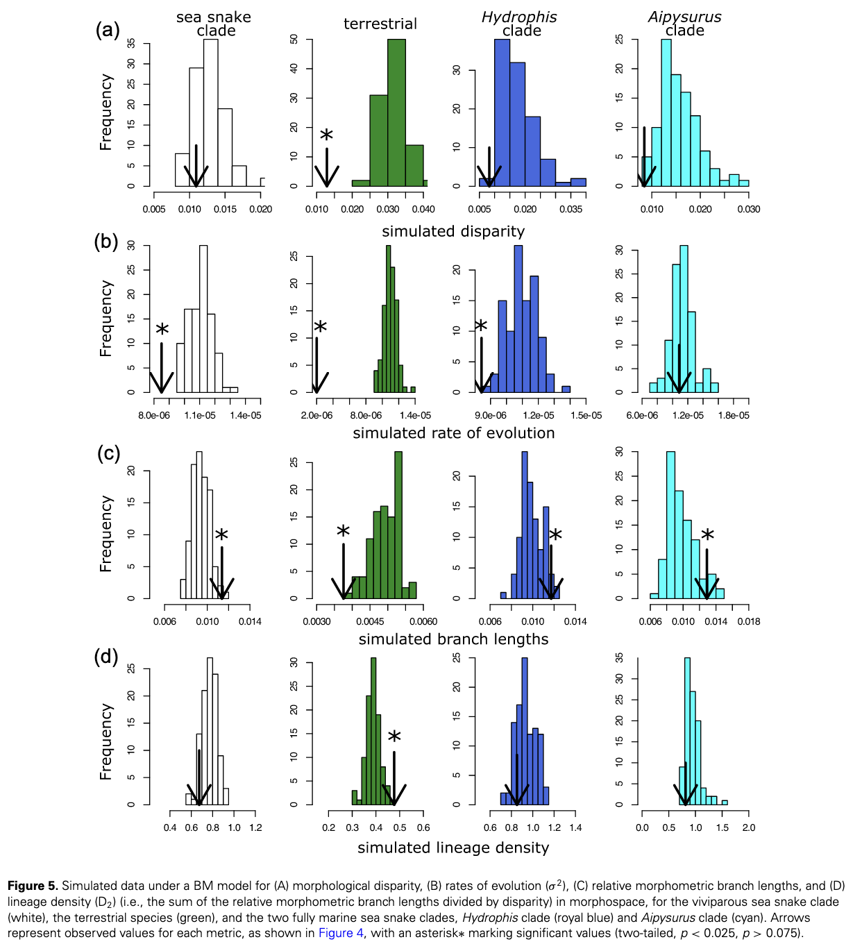

Slide 23
OU? BM? Optima? Regimes?
Principal components analysis?
Landmarks?
Morphospace? Phylomorphospace?
Phylogenetic ridge regression?
Since different clades had different rates of morphological change, would it make all the previous trees built based on morphological traits highly unreliable?
In the third paragraph on the right side of page 8, the authors state that their findings are similar to what is known about the Anolis radiation, but mention that there are different patterns of tempo and mode between the two systems, with Anolis having higher disparity, longer branch lengths, and similar rates of morphological evolution, while sea snakes have less disparity, longer phenotypic branch lengths, and higher rates of morphological evolution. Why do these differences exist?
I am a bit confused about their broader conclusion that the switch in habitat caused this morphological change. I understand all the indiviual pieces of evidence, but I can't put them all together in a cohesive and non contradictory way. I think it is the early burst itself that is getting me. What does that mean and why is it producing snake skulls that don't differ all that much in the present day but show an uptick in evolution rate in the past? Is that saying there was a big change in the past when the snakes first went into the marine environment (kinda a cambrian explosion type deal), where different morphospaces are being tried out, but as time goes on, it stablizes onto morphospaces that work in the marine enivronment. But wouldn't that produce differences we would get in the ANCOVA?
How scalable is a technique like X-ray tomography? This seems like an awesome morphotyping/phenotyping approach.

